Slide 1
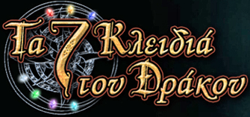
The 7 Keys of the Dragon: An e-learning game-like environment for Albanian and Russian
EUROCALL 2014
Groningen, 20-23 August 2014
Anthi Revithiadou, Vasilia Kourtis-Kazoullis, Maria Soukalopoulou, Konstantinos Konstantoudakis, Christos Zarras & Nestoras Pelesoglou
Acknowledgements: This research was supported by the Program ‘Education of Immigrant and Repatriate Students’ funded by The National Strategic Reference Framework (NSRF) 2007-2013 and national resources. The expenses for the EUROCALL conference were covered by the Grant 91182 (awarded to Dr A. Revithiadou).
Notes:
Good afternoon! My name is Maria Soukalopoulou and I am going to present a collaborative work on the design of “Τα 7 κλειδιά του δράκου” an e learning environment for the teaching of Albanian and Russian as heritage languages to students that study in Greek elementary and secondary schools.

Slide 2
Outline
The Context
Challenges & Design considerations
Access
Learners’ profile
User-friendliness
Pedagogy
Decisions– theoretical framework, pedagogical & design aspects
Notes:
As shown in the outline, my talk will commence with the presentation of the context this e learning environment was developed.
In doing so, I will also try to address the challenges we met and the design requirements we took into consideration during the conceptualization stage of the project development. Some key decisions had to be made in terms of Access possibilities, the Age of our target learners groups, the User-friendliness of the end product for both the teachers and the learners and finally its pedagogical background.
The second part of the presentation is devoted to the decisions and the design choices we made as a team in response to the aforementioned challenges. Due to time limits I will show you screenshots of the 7 keys but whoever is interested can always contact me after the talk in order to have a look at the online environment.

Slide 3
The Context
Action 5: Reinforcement of the mother tongue
Language classes of Albanian and Russian as heritage languages
Construction of targeted linguistic material (i.e., textbooks and grammars) for Albanian and Russian students with Greek as L1
Design and development of an interactive e-learning environment: 7 Keys of the Dragon
Notes:
The environment I am going to present today was created within the Project ‘Education of immigrant and repatriate students’ and Action 5 funded by the National Strategic Reference Framework (NSRF) 2007-2014 and Greek national resources.
The mother tongue language classes for Albanian and Russian were organized in several schools as part of a pilot program (2011-2013). For this purpose, a team of linguists, education and bilingualism specialists and Albanian/Russian-speaking writers-editors of educational materials, designed and constructed language learning materials in the form of textbooks and grammars and also produced a game-like e-learning environment, dubbed the 7 Keys of the Dragon (henceforth 7Keys) to supplement the materials created for the language classes.

Slide 4
Design Considerations
Access
Learners’ profile
User friendliness
Pedagogy
Notes:
The first design challenge we had to encounter has to do with Access CLICK

Slide 5
Access
The challenge:
limited hours for language classes provided by the schools to the Program.
The decision:
the design of a supplementary language learning environment for independent study with emphasis on form-focused practice so that more classroom time could be dedicated to the development of communicative competence
Notes:
I should mention that the limited hours of language teaching provided by the school to the Program was the major motivating factor for us to enhance the learning experience by providing a supplementary language learning environment. This environment was aimed to put emphasis on form focused practice both for in-class use and especially for open access mode so that more …

Slide 6
Design Considerations
Access
Learners’ profile
User friendliness
Pedagogy

Slide 7
Learners’ profile
Young students (9-13 years old) of primary and secondary education
Characteristics of the group:
unclear level of digital literacy
diverse language proficiency level (ranging from basic to advanced, but with poor writing and reading skills) defined by placement tests
Notes:
Our target group consisted of young students between 9-13 years old of primary and secondary education…. Common characteristics of the group like the unclear level of their digital literacy, the diverse language proficiency skills and the need for a controlled and motivating learning were challenges we had to take in mind.

Slide 8
Design Considerations
Access
Learners’ profile
User friendliness
Pedagogy

Slide 9
User-friendliness
Relatively controlled environment
Navigation assistance
Clear and motivating interface design
Notes:
User-friendliness here is intended to refer to both the language instructors/teachers and the students.
With respect to the language instructors, it is not uncommon in the CALL to encounter teachers who lack digital literacy and as a result they are unwilling to integrate CALL into the language classroom. Given this situation, our top priority was to provide a teacher friendly environment. We wanted to ensure teachers’ involvement in the development use and further enrichment of the language material.
Furthermore taking into account the learners’ young age and being unaware of the extent of their familiarity with e-learning we wanted to develop a learner friendly environment in order to allow them to smoothly navigate in an open access mode.

Slide 10
Design Considerations
Access
Learners’ profile
User friendliness
Pedagogy

Slide 11
Pedagogy
Our goal was the 7Keys to be placed in a rigid pedagogical framework so that it can:
accommodate different levels of language proficiency
stimulate form-focused practice
motivate student-teacher interaction
provide personalized feedback to students
increase students’ motivation and involvement
Notes:
Finally, we aimed at developing the 7 keys on a rigid pedagogical framework which I will discuss in detail in the following slide. Among our main concerns was the need to cater for different levels of language proficiency, to stimulate form-focused practice to motivate student-teacher interaction in an open access mode and to successfully provide personalized feedback to students.

Slide 12
7 Keys of the Dragon
Theoretical framework:
Cummins’ theoretical framework for the Development of Academic Expertise (2000)
Pedagogical and Design aspects:
User structure
7 keys student application:
Main characteristics (storyline, menu, navigation, assistants)
Texts and (language-based) activities
In-built communication
Client-server structure
Notes:
So far I presented the challenges we met during the design of the 7Keys. In the remainder of my presentation I will present the design choices we made in order to respond at the best possible way to the above mentioned challenges. The theoretical framework the 7 keys was based on was the Development of Academic Expertise proposed by Cummins, which I will elaborate on in a minute. I will also provide examples on the environments’ pedagogical and design aspects with respect to the user structure, texts, activities and features of the 7 keys student application, the inbuilt messaging system and finally the client-server structure

Slide 13
Cummins’ Framework for the Development of Academic Expertise (2000)
Focus on Language
Enhancing awareness of language forms and uses
Developing critical analysis of language forms and uses
Focus on Meaning
Making input comprehensible
Developing critical literacy
Language exercises and activities
Comprehension exercises and activities
Focus on Use
Using language to:
generate new knowledge
create literature and art
act on social realities
Production & publication of literary texts
Notes:
This slide depicts the basic layout of Cummins’ theory
Activities that focus on language are designed to cultivate an awareness and critical analysis of language forms and uses. Activities of this sort help students understand the similarities/differences between Greek and Albanian/Russian. Activities that focus on meaning are geared to making input comprehensible and to developing critical literacy. Activities that focus on use are designed so as to allow students to use language in creative ways.

Slide 14
User Structure
Access
Offers decentralized teaching and student management
(a different application for each user type)
Offers centralized administration/ curriculum control
Provides opportunities for personalized student-teacher interaction (feedback, assignments, communication)
Creates teacher accounts
Adds and modifies texts and exercises
Communicates via an in-built messaging system with the teachers
Makes announcements for the students
Creates student accounts
Provides feedback to students’ answers to the exercises
Grades students’ essays
Publishes selected students’ work in the platform’s magazine
Communicates via an in-built messaging system with students and the administrator
Student
Teacher
Student
Learners’ profile
Student
Teacher
Student
Student
Admin
Student
Teacher
Student
User-friendliness
Student
Student
Teacher
Student
Notes:
This slide shows the 7 keys environment user structure.
The user structure environment was designed to follow the class/school structure: More specifically, users of the 7Keys are divided into three distinct tiers: student, teacher, and administrator, each of them working on a separate application.
Some of the advantages of this pyramid-like structure are the following: CLICK
Let us now look briefly at the roles of the administrator and the teachers in the 7 keys environment. CLICK Working on a different application, which I will not present today due to time considerations/limitations, the administrator…….
Teachers CLICK also work in a different application where they can create…..

Slide 15
Login Page
Notes:
This is the login page of the student’s application. The student insert the username and the password given by the teacher/instructor and is directed into his/her own personalized working space.

Slide 16
Storyline
Learners’ profile
Story
Graphics
Sound/ Music
Notes:
Since The 7Keys is addressed to young learners we decided to set it up as a game-like environment set on the basis of a fantasy storyline: The Dragon has captured the Wizard of an imaginary village, and the students can only help free him if they collect enough points that would allow them to gain the 7 Keys of wisdom. This can be accomplished only if they complete certain activities. The graphics are designed to match and enhance the user’s introduction to the imaginary world and are supplemented by music, sound effects and two animated videos.

Slide 17
Main Menu
Start
Magazine
Profile
Project team
Notes:
Students’ application consists of three distinct units which they can access by clicking on either the start button, the magazine button or the profile button.

Slide 18
Assistants
Access
Learners’ profile
User-friendliness
Pedagogy
Notes:
In this opening page students can select the text they would like to work on.
In-game assistance is provided by two cartoon-like characters: the Dragon, who provides navigation details and the Wizard’s young Apprentice, who provides assistance in the language tasks pointing to specific chapters of the accompanying grammar theory document.

Slide 19
Internal Structure: Texts & Activities
Access
To accommodate the students’ different proficiency levels and language needs (additionally catered for via various methods e.g. scaffolding)
Activities
Pedagogy
Focus on language
Exercise 1
Level 1
Exercise 2
Text
Focus on meaning
Level 2
Level 3
Focus on use
Exercise ν
Notes:
As you can see the activities of each text have three different foci: Focus on language, focus on meaning and focus on use. Each type of focus is divided in three different levels of language proficiency. CLICK This structure is assumed to be better suited to the students’ differentiated proficiency levels. What’s more we tried to cater for the learners’ individual language needs via various methods such as scaffolding an example of which I will present you in the following slide.

Slide 20
Text Features
Access
Translation
Glossary
Synchronized narration
Pedagogy
Notes:
This is an example of text comprehension and its accompanying scaffolding features. In their effort to comprehend the text students’ can make use of different types of scaffolding according to their language needs and learning styles: Students read the text, read the Greek translation, choose to consult the glossary or listen to a native speaker read the text out loud, with an option of highlighting the text in sync with the narration or hide it entirely. The student may also have the narration move to a specific point in the text by clicking on it.

Slide 21
Types of Activities
True/false
Multiple choice
Fill-in-the blanks
Fill-in-the- table
Sorting
Pairing
Listening
Crosswords
Essays
Non-gradable activities
Notes:
To cater for learners’ different language needs a range of 10 different activity types was employed..The types of activities one can find in the 7 keys environment are: CLICK All activities are automatically graded except for essays. Essay grading requires the teacher, and upon submission, a notification is sent to the teacher's account, flagging the essay as ungraded.

Slide 22
Features of Activities
Access
Full/half screen (Text Translation/ Glossary
Feedback (automated/ personalized comments by teacher)
Bilingual instructions / L1 use
Pedagogy
Notes:
In the slide you can see a fill in the table activity. In this particular exercise learners have to fill Shasha’s Karamelkin nutrition programme. The activities are laid out dynamically, with an option to view the exercise on either half or full screen. Full screen provides a more comfortable view, while half screen view enables the student to see the text, translation or glossary in the other half.
As mentioned above all exercises are graded automatically.

Slide 23
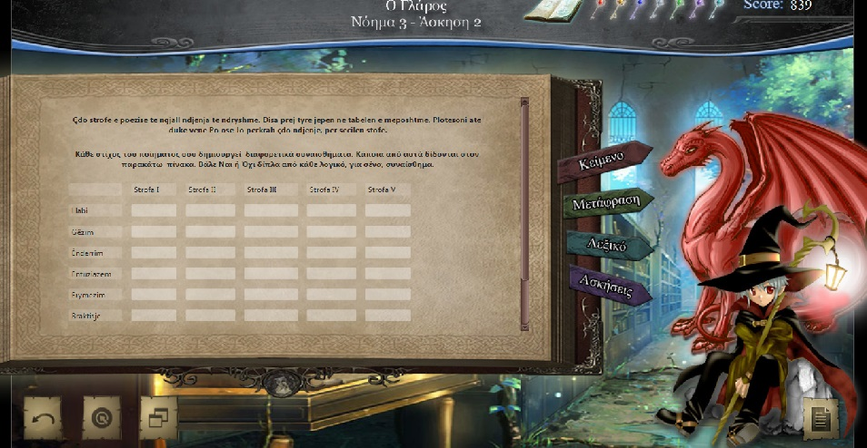
Navigation
User-friendliness
Notes:
Concerning the navigation features, as I mentioned already that the Dragon character provides help to the students with navigating through the environment.
However, smooth navigation through the environment is also ensured via various extra features like: All buttons used are intuitive while a headline on top of the page notes the chapter, the focus and the exercise students are working on so that they always know their “position” in the environment. Finally a click on the central button gives them easy access to the main menu.

Slide 24
Profile
Access
Pedagogy
Badges
Progress bars
Portfolio
Learners’ profile
Notes:
Completing the game-like feeling and providing extra motivation, the students can earn badges for specific achievements (e.g., scoring perfect in a multiple choice quiz) and can track their own performance on different language foci through their profile.

Slide 25
In-built Communication
Access
Pedagogy
Student-Teacher interaction, personalized feedback
Teacher to all students in group (instructions)
Administrator to all users (announcements)
Notes:
Well-known by now
An in-built communication system facilitates student-teacher interaction and offers an easy and effective way to personalized feedback. The same mailing system can be used by teachers to send instructions to all students as well as by the administrator in order to post class announcements.

Slide 26
Client-server Structure
Access
Clients (student, teacher, administrator applications developed using JavaFX 2)
Database (built with MySQL)
Server (deployed using Glassfish)
Key attributes:
Portability
Auto update
Extendability (activities, texts, language)
Notes:
The 7Keys e-learning environment consists of five distinct units: the student, teacher, and administrator clients, each providing functionality appropriate to each user type; the database, in which all data is stored, including user data and educational data; and the server, which facilitates communication between the clients and the database.
All data, including user information, learning material and user answers to activities, is stored in, and retrieved from, an online database. An embedded updater automatically downloads the latest version of the application, ensuring all users are always up to date.
The clients and server were developed using JavaFX 2, with the server being deployed using Glassfish, while the database was built with MySQL.
New texts and activities can be added over time using the administrator application, which also provides an environment for user management.

Slide 27
Where to find the 7 Keys of the Dragon http://www.diapolis.auth.gr/index.php/2013-10-17-09-02-51/7-keys-of-dragon
Notes:
The 7 Keys of the Dragon was awarded the European Language Label 2013 excellence distinction

Slide 28
References
Cummins, J. (2000) Language, Power and Pedagogy: Bilingual Children in the Crossfire. Clevedon: Multilingual Matters

Slide 29
Contact details
Anthi Revithiadou (Scientific coordinator)
revith@lit.auth.gr
Vasilia Kourtis-Kazoullis (theoretical framework)
kazoullis@rhodes.aegean.gr
Maria Soukalopoulou (pedagogical design)
mariasoukalopoulou@hotmail.com
Konstantinos Konstantoudakis (technological implementation)
kkonstant@ee.auth.gr

